Slide 1
Java Programming Unit II – Chapter 10 Exception Handling

Slide 2
Contents
Exception – Fundamentals
5 Keywords and Syntax
Exception Types
Multiple Catch Clauses
Nested Try
Throw, Throws, Finally
Creating Own Exceptions
Chained Exceptions

Slide 3
What is an Exception?
An exception is an abnormal condition that arises in a code sequence at run time
Run-time error
Error?
Fundamental errors that violate the rules of the Java language or constraints of the Java execution environment.
Java treats exception as “object”
This object describes the exceptional (error) condition that has occurred in a piece of code.

Slide 4
Fundamentals
When an exceptional condition arises
An object representing that exception is created and
Thrown in the method that caused the error.
That method may choose a way to handle the exception.
Hence, the thrown exception is caught and handled by this method

Slide 5
5 Keywords
try
Block that contains the program statements that are monitored.
Exceptions, if any, are thrown by “try block”
Catch
Block that catches the thrown exception and handles it.
Present immediately after “try”
Throw
Used to throw manually generated exceptions (System generated exceptions are thrown automatically)
Throws
Any exception that is thrown out of a method, uses throws clause
Finally
Contains a code, that should be executed for any case of exception

Slide 6
Syntax
try {
// block of code to monitor for errors
}
catch (ExceptionType1 exOb) {
// exception handler for ExceptionType1
}
catch (ExceptionType2 exOb) {
// exception handler for ExceptionType2
}
// ...
finally {
// block of code to be executed after try block ends
}

Slide 7
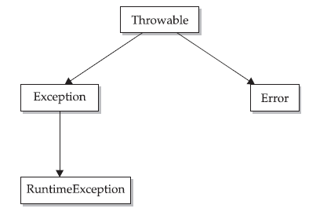
Exception Types
Super Class
SubClasses of “Throwable”
SubClass of “Exception”

Slide 8
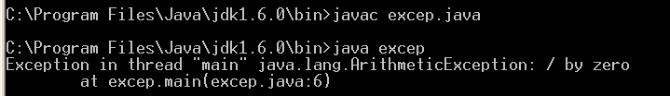
class excep
{
public static void main(String arg[])
{
int d=0;
int a=58/d;
System.out.println("a="+a);
System.out.println("After exception");
}
}
The exception is handled by
“default exception handler” of JVM

Slide 9
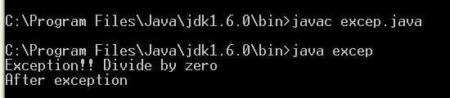
Using try and catch
class excep
{
public static void main(String arg[])
{
int d=0;
int a=0;
try
{
a=58/d;
System.out.println("a="+a);
}
catch(ArithmeticException e)
{
System.out.println("Exception!! Divide by zero");
}
System.out.println(“After exception”);
}
}

Slide 10
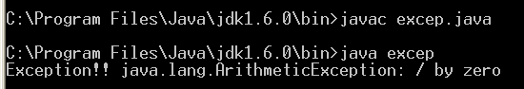
Displaying a Description of an Exception
class excep
{
public static void main(String arg[])
{
int d=0;
int a=0;
try
{
a=58/d;
System.out.println("a="+a);
}
catch(ArithmeticException e)
{
System.out.println("Exception!! "+e);
}
}
}

Slide 11
Multiple Catch Clauses
More than one exception could be raised by a single piece of code.
Hence specify two or more catch clauses, each catching a different type of exception.
When an exception is thrown, each catch statement is inspected in order,
The first one whose type matches that of the exception is executed.
After one catch statement executes, the others are bypassed

Slide 12
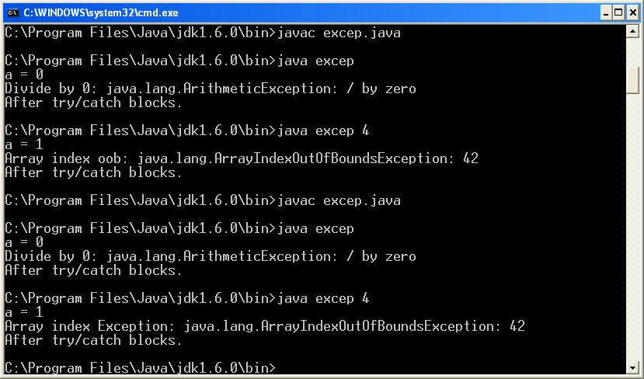
class excep
{
public static void main(String args[])
{
try
{
int a = args.length;
System.out.println("a = " + a);
int b = 42 / a;
int c[] = new int[3];
c[42] = 99;
}
catch(ArithmeticException e)
{
System.out.println("Divide by 0: " + e);
}
catch(ArrayIndexOutOfBoundsException e)
{
System.out.println("Array index Exception: " + e);
}
System.out.println("After try/catch blocks.");
}
}

Slide 13
Types of Exception used:
All these are subclasses of “Exception”
ArithmeticException
ArrayIndexOutOfBoundsException
…
…
Hence, when 1st catch catches super class Exceptions, the sub classes catch block are not visited

Slide 14
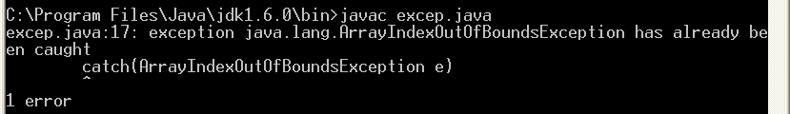
class excep
{
public static void main(String args[])
{
try
{
int a = args.length;
System.out.println("a = " + a);
int b = 42 / a;
int c[] = new int[3];
c[42] = 99;
}
catch(Exception e)
{
System.out.println("Divide by 0: " + e);
}
catch(ArrayIndexOutOfBoundsException e)
{
System.out.println("Array index Exception: " + e);
}
System.out.println("After try/catch blocks.");
}
}

Slide 15
Nested “try” Statements
A try statement can be inside the block of another try
Each time a try statement is entered
The context of that exception is pushed on the stack.
If an inner try statement does not have a catch handler for a particular exception,
the stack is unwound and the next try statement’s catch handlers are inspected for a match.
This continues until one of the catch statements succeeds, or until all of the nested try statements are exhausted.
If no catch statement matches
then the Java run-time system will handle the exception

Slide 16
Syntax
try {
// try 1 block of code
try
{
//try2 block of code
}
catch (Excep1 ex1) {
// exception handler for Type1
}
}
catch (Excep2 ex2) {
// exception handler for Type2
}
//Error…
Try block should have at least one catch block

Slide 17
Syntax
Exception Stack
try1 catch Excep2 handler
try2 catch Excep1 handler
try2 block
try1 block
try {
// try1 block generating excep1
try
{
//try2 block generating excep2
}
catch (Excep1 ex1) {
// exception handler for Type1
}
}
catch (Excep2 ex2) {
// exception handler for Type2
}
TOS
generating excep2
generating excep1
JVM Default Handler will handle this

Slide 18
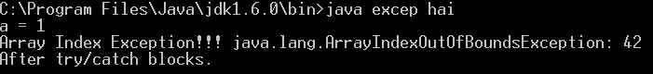
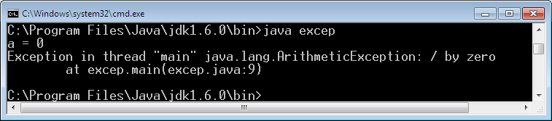
class excep
{
public static void main(String args[])
{
try
{
int a = args.length;
System.out.println("a = " + a);
int b = 42 / a;
try
{
int c[] = new int[3];
c[42] = 99;
}
catch(ArithmeticException e)
{ System.out.println("Divide By Zero!!!! " + e); }
}
catch(ArrayIndexOutOfBoundsException e)
{ System.out.println("Array Index Exception!!! " + e); }
System.out.println("After try/catch blocks.");
} }

Slide 19
throw
program to throw an exception explicitly, using the throw statement.
throw ThrowableInstance;
ThrowableInstance must be an object of type Throwable or a subclass of Throwable
There are two ways you can obtain a Throwable object
using a parameter in a catch clause
creating one with the new operator

Slide 20
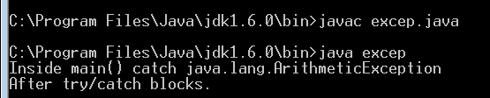
class excep
{
public static void main(String args[])
{
try
{
throw new ArithmeticException();
}
catch(ArithmeticException e)
{
System.out.println("Inside main() catch " + e);
}
System.out.println("After try/catch blocks.");
}
}

Slide 21
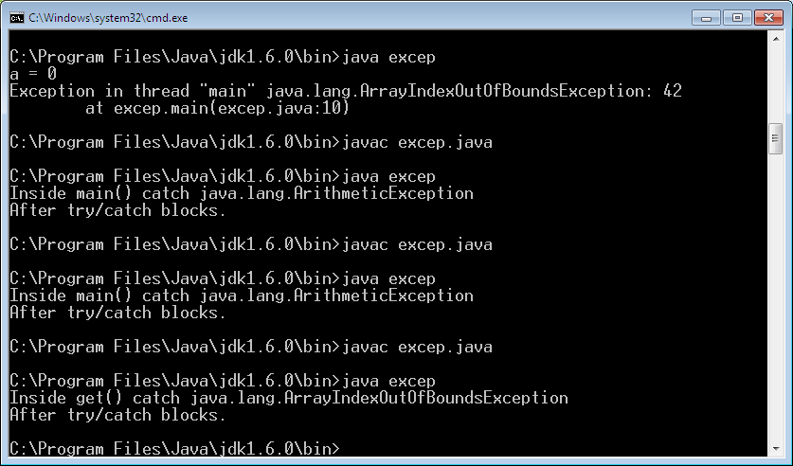
class sam
{
void get() {
try
{
throw new ArrayIndexOutOfBoundsException();
}
catch(ArrayIndexOutOfBoundsException e)
{
System.out.println("Inside get() catch " + e);
}
} }
class excep
{
public static void main(String args[]) {
try
{ sam s=new sam();
s.get();
}
catch(ArithmeticException e)
{
System.out.println("Inside main() catch " + e);
}
System.out.println("After try/catch blocks.");
} }

Slide 22
class sam
{
void get() {
try
{
throw new ArithmeticException();
}
catch(ArrayIndexOutOfBoundsException e)
{
System.out.println("Inside get() catch " + e);
}
} }
class excep
{
public static void main(String args[]) {
try
{ sam s=new sam();
s.get();
}
catch(ArithmeticException e)
{
System.out.println("Inside main() catch " + e);
}
System.out.println("After try/catch blocks.");
} }
Like Nested try – Exception Stack

Slide 23
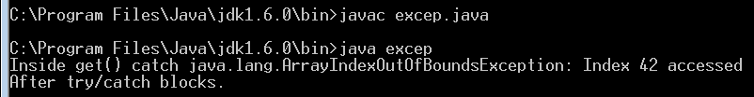
class sam
{
void get() {
try
{
throw new ArrayIndexOutOfBoundsException("Index 42 accessed"); }
catch(ArrayIndexOutOfBoundsException e)
{
System.out.println("Inside get() catch " + e);
}
} }
class excep
{
public static void main(String args[]) {
try
{ sam s=new sam();
s.get();
}
catch(ArithmeticException e)
{
System.out.println("Inside main() catch " + e);
}
System.out.println("After try/catch blocks.");
} }

Slide 24
throws
Methods that cannot/will not handle the exceptions thrown, may use “throws” clause to handle it in some other way.
Throws clause lists the types of exceptions that a method might throw
return-type method-name (params) throws Exception-List
{ … }
public static void main(String args[]) throws Exception

Slide 25
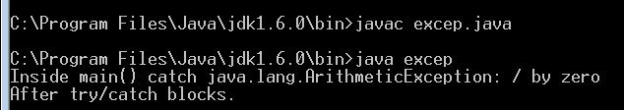
class sam
{
void get() throws ArithmeticException
{
int a=98/0;
}
}
class excep
{
public static void main(String args[])
{
try
{
sam s=new sam();
s.get();
}
catch(ArithmeticException e)
{
System.out.println("Inside main() catch " + e);
}
System.out.println("After try/catch blocks.");
} }
// No try and catch blocks here…

Slide 26
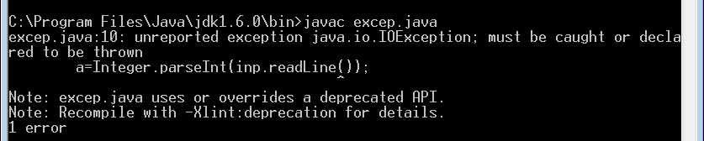
import java.io.*;
class excep
{
public static void main(String args[])
{
DataInputStream inp=new DataInputStream(System.in);
System.out.println("Enter a value:");
int a;
a=Integer.parseInt(inp.readLine());
System.out.println("value of a="+a);
}
}

Slide 27
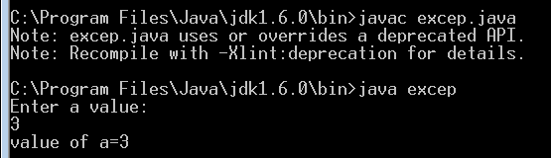
import java.io.*;
class excep
{
public static void main(String args[]) throws Exception
{
DataInputStream inp=new DataInputStream(System.in);
System.out.println("Enter a value:");
int a;
a=Integer.parseInt(inp.readLine());
System.out.println("value of a="+a);
}
}

Slide 28
finally
Problem in Exceptions:
Non-Linear flow of control in code execution
Some part of the code, inside the exception block, may not be executed
Methods are exited prematurely
E.g.., Opened files are to be closed
The finally is designed to address this contingency.
finally = block of code that is executed after a try /catch block has completed and before the code following the try/catch block

Slide 29
finally
The finally block will execute whether or not an exception is thrown, whether or not catch matches
This can be useful for closing file handles and freeing up any other resources that might have been allocated at the beginning of a method
However, each try statement requires at least one catch or a finally clause.

Slide 30
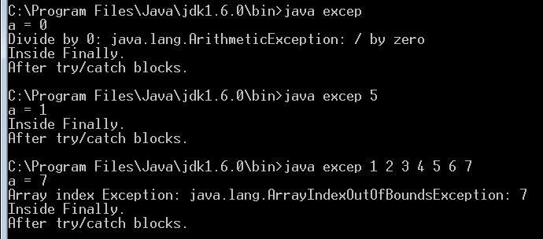
class excep
{
public static void main(String args[])
{
try
{
int a = args.length;
System.out.println("a = " + a);
int b = 42 / a;
int c[] = new int[2];
c[a] = 99;
}
catch(ArithmeticException e)
{ System.out.println("Divide by 0: " + e); }
catch(ArrayIndexOutOfBoundsException e)
{ System.out.println("Array index Exception: " + e); }
finally
{ System.out.println("Inside Finally."); }
System.out.println("After try/catch blocks.");
}
}

Slide 31
Java’s Built-in Exceptions
Inside the standard package java.lang
these exceptions need not be included in any method’s throws list
These are called unchecked exceptions because the compiler does not check to see if a method handles or throws these exceptions
Handled by JVM

Slide 32
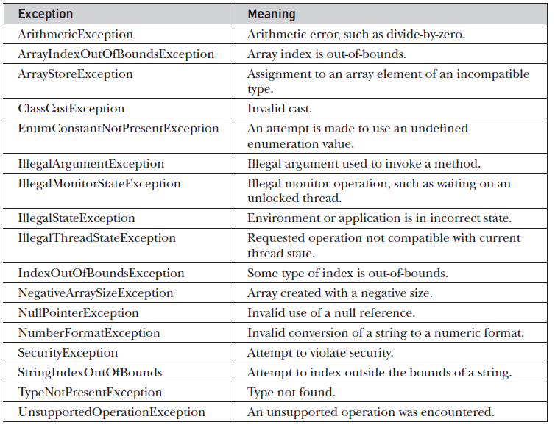

Slide 33
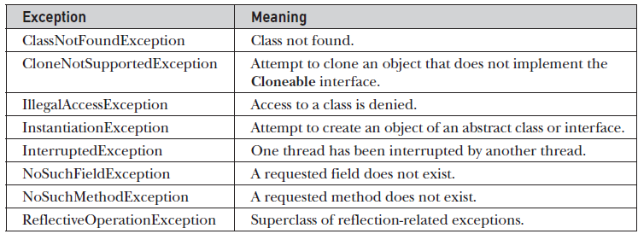
Checked Exceptions
Compiler checks to see if a method handles or throws these exceptions

Slide 34
Creating Own Exceptions
Used to create “Application-Dependent” Exceptions
Idea: Create user-defined class – which is the subclass of “Exception” (thereby subclass of “Throwable”)
Use the following methods of “Throwable” class:
String getMessage()
Returns the description of the exception
String toString()
Returns the description. But called by println()

Slide 35
Constructors of Exception
4 public constructors:
For Normal Exceptions:
Exception()
Exception(String msg)
For Chained Exceptions:
Throwable(Throwable causeExcep)
Throwable(String msg, Throwable Excep)

Slide 36
Syntax – User defined Exceptions
class <new_excep> extends Exception
{
public String toString()
{
return “message”;
}
}
class sample
{
public static void main(String args[]) throws new_excep
{
…
throw new new_excep();
…
}
}

Slide 37
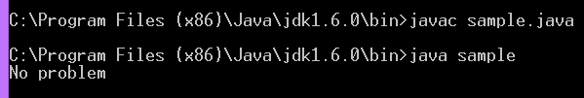
class Age_Negative extends Exception
{
public String toString()
{
return "OOPS!!! Age cannot be Negative";
}
}
class sample
{
public static void main(String args[]) throws Age_Negative
{
int x=10;
if(x<0)
throw new Age_Negative();
else
System.out.println("No problem");
} }

Slide 38
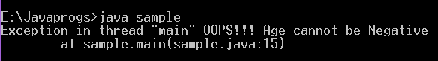
class Age_Negative extends Exception
{
public String toString()
{
return "OOPS!!! Age cannot be Negative";
}
}
class sample
{
public static void main(String args[]) throws Age_Negative
{
int x=-10;
if(x<0)
throw new Age_Negative();
else
System.out.println("No problem");
} }

Slide 39
Chained Exceptions
A feature that allows to associate an exception with another exception
The second exception describes the cause of the first one.
2 new methods:
Throwable getCause()
Throwable initCause(Throwable CauseExcep)

Slide 40
Thank You

